Slide 1
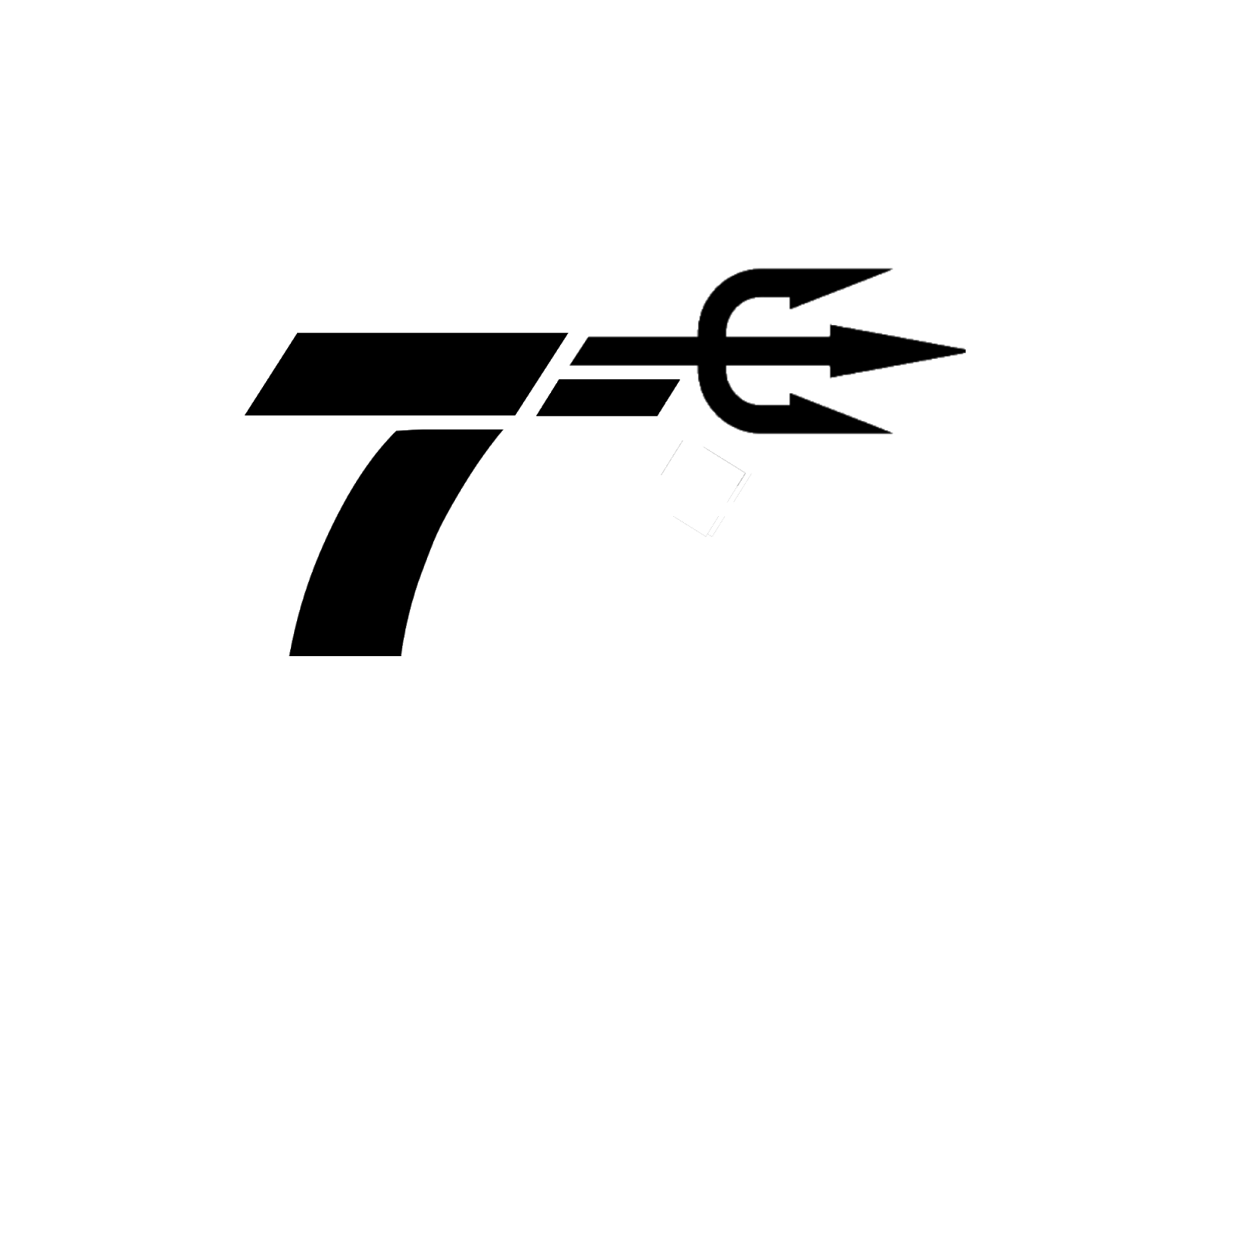

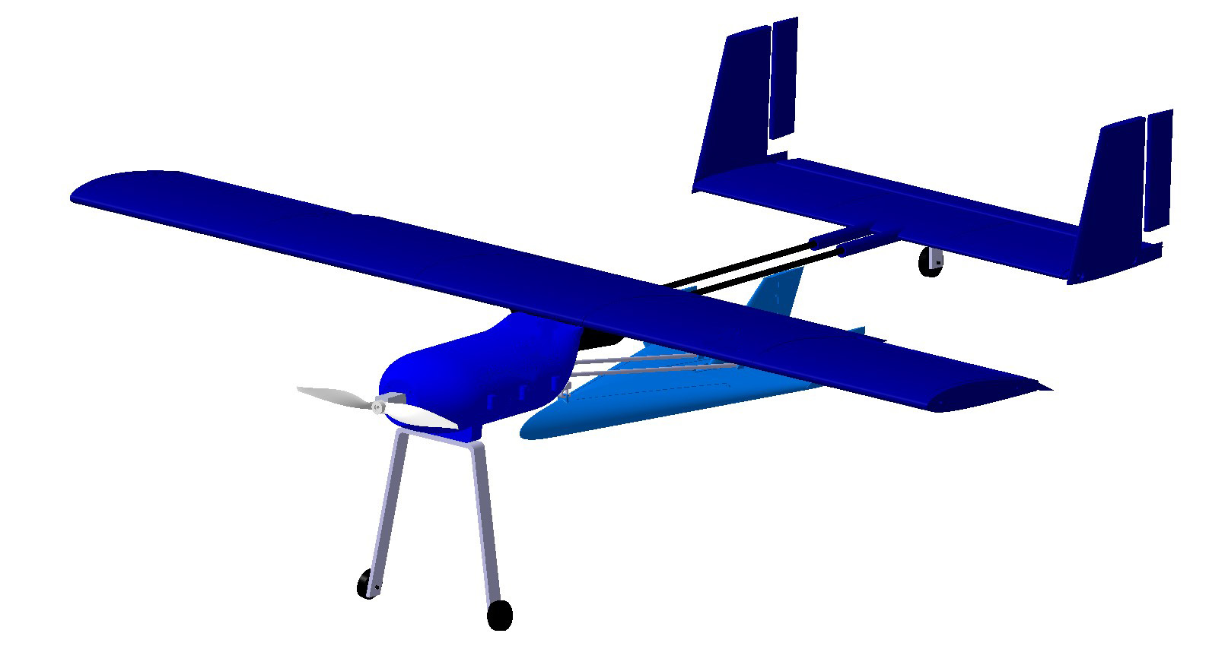

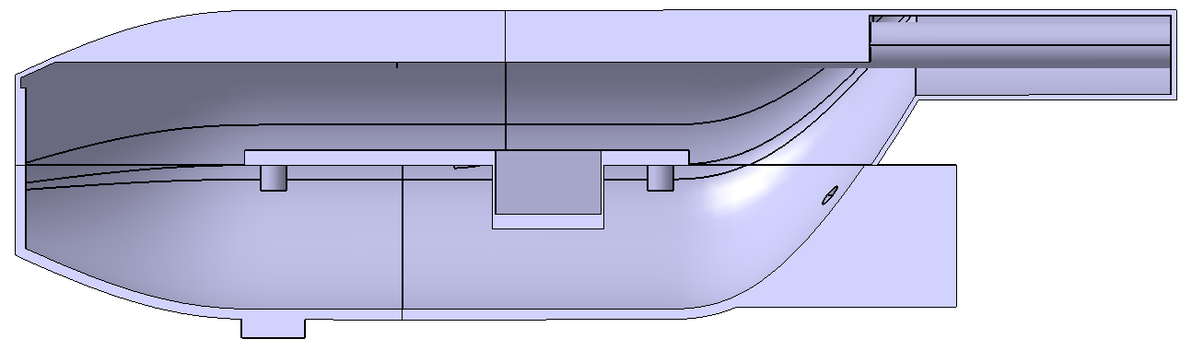
.
Team 7 Mothership
Poseidon
Benjamin Dolin, Elias Ghazal, Bradley Lock, Sarah Rasche, Sean Wan, Veronica Yapriadi
.
Project Objective
Interface Mechanism
Something about back ground of project
Veronica
Interface Mechanism with picture and write up
Brad
Color Scheme?
Walk Around
The aircraft is a high wing, H-tail configuration with a double carbon fiber rod boom connecting the fuselage and the tail. The glider is placed underneath the booms and connected to the fuselage. The fuselage holds all of the electronics and the motor is attached to the outside of the fuselage. The landing gear is a tail dragger configuration to allow space for the glider.
Table of general performance parameters
Fuselage Interior
Graphs about Aero and write up about aero
Elias
Graphs about Stability and write up about Stability
Elias
Graphs about Prop and write up about prop
Veronica
Wing Design
Wing and elevator design
Ben
The fuselage is designed modularly with a electronics holding platform that’s removable for easy access. The platform would be holding the ESC and battery. The motor would be mounted in front of the fuselage. The glider release servo is placed in the lower compartment. Six bolts are in place to make the fuselage interior easy accessible.
.

